Slide 1

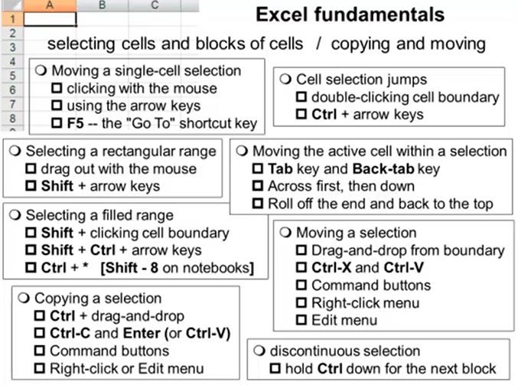
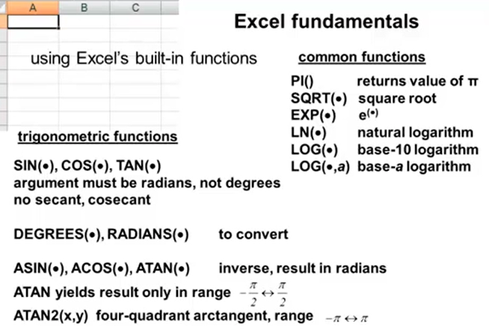
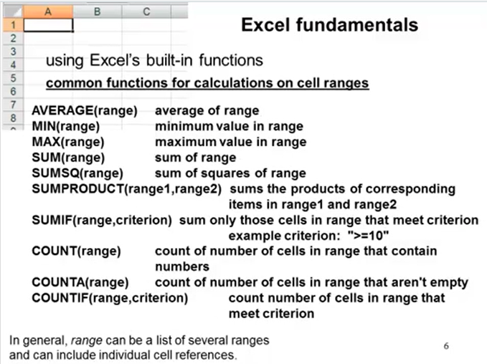
Force the content of cell that starts with = into a label instead of a formula by putting ‘ in front of the = sign:
gives

Slide 2
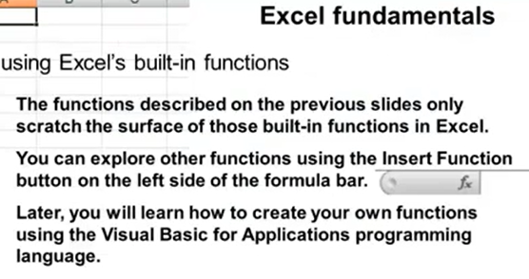
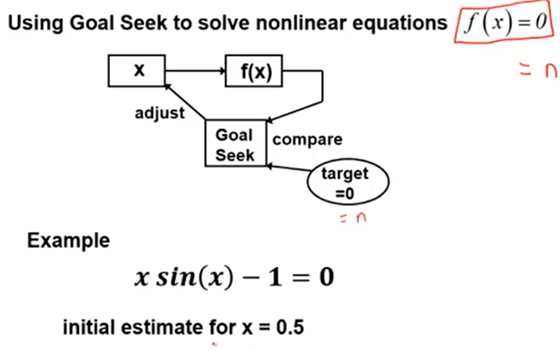
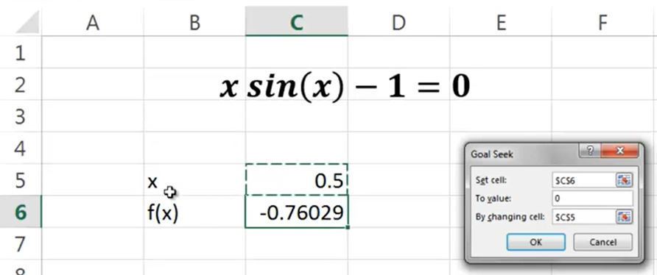
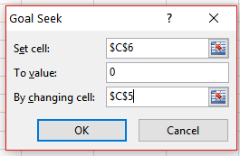
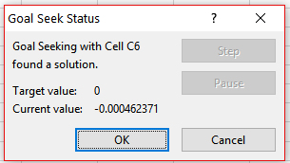
Goal Seek
Data Tab -> What If Analysis -> Goal Seek

Slide 3
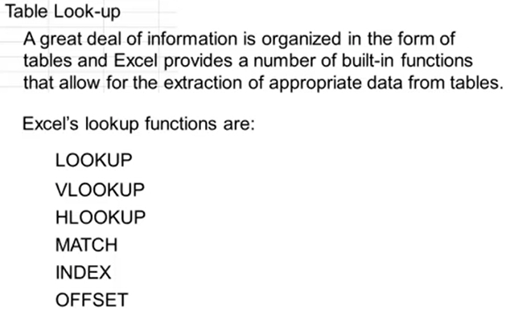
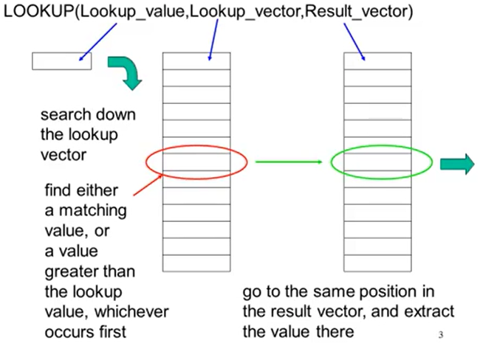
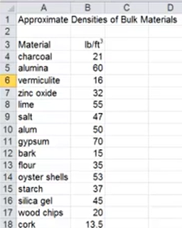
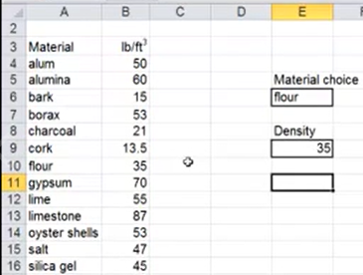
Look-up Functions
Remember to sort the variable that you want to look up into alphabetical order
choice
material
density
Lookup has the disadvantage that if choice is misspelt say “flaur” instead of “flour”, then lookup will use the previous choice value which is “cork” and gives 13.5 instead of the desired “error” message to tell us that our choice variable doesn’t exist.
This is why we use vlookup instead

Slide 4
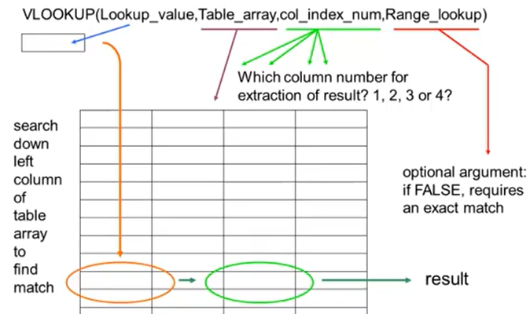
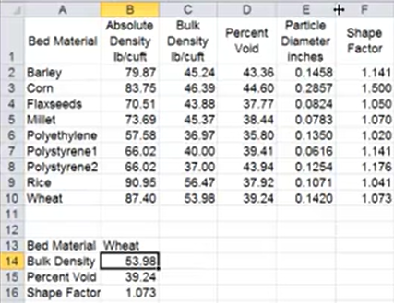

MaterialTable
choice
=vlookup(choice, MaterialTable, 3, FALSE)
=vlookup(choice, MaterialTable, 4, FALSE)
=vlookup(choice, MaterialTable, 4, FALSE)
Now if we misspelt “Wheat” it results will become #N/A to tell us that our choice has a problem

Slide 5
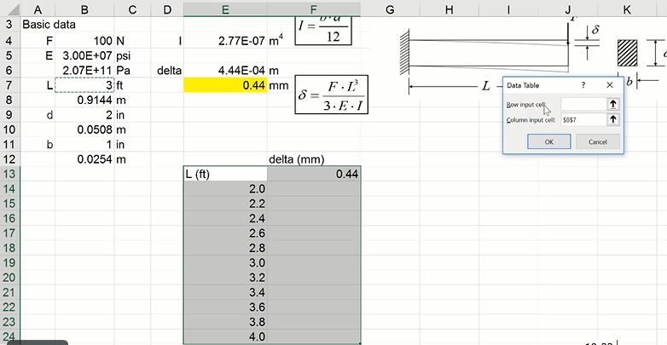
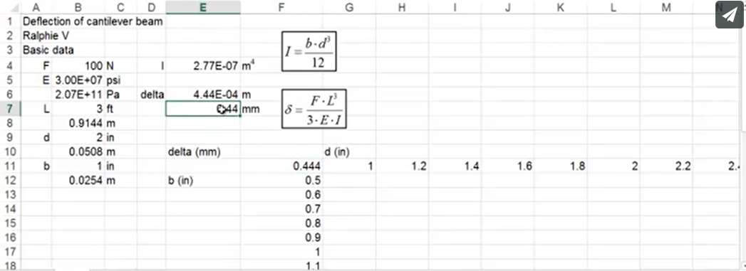
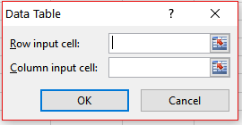
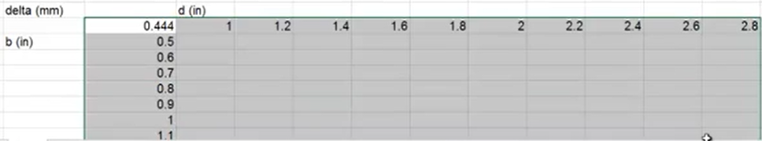
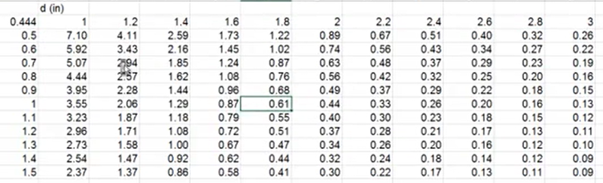
One Way Data Table
=E7
Highlight the table -> Data Tab -> What If Analysis -> Data Table -> select the column input cell in this case is $B$7, and leave the Row input cell blank.
Click OK to give
Two Way Data Table
$B$9
$B$11
Click OK to give

Slide 6
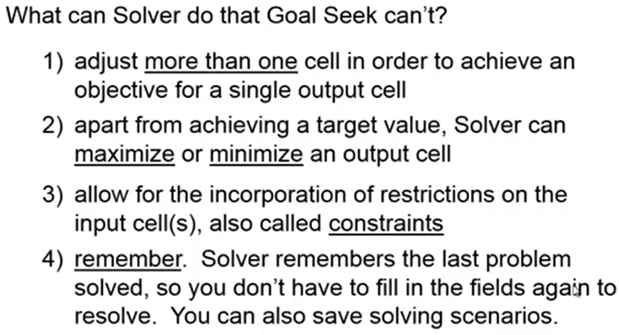
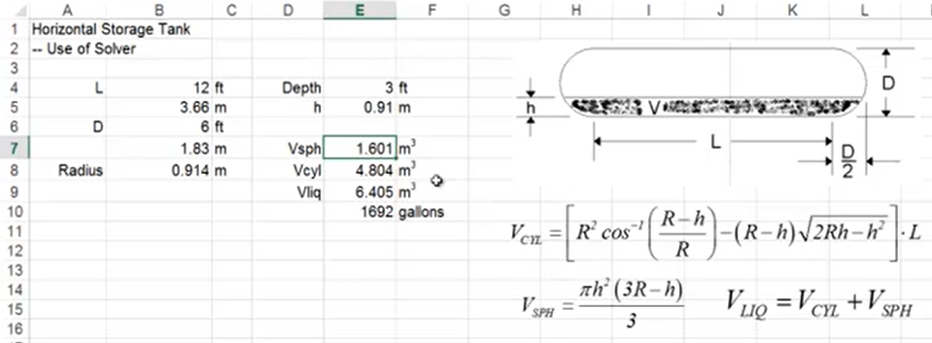
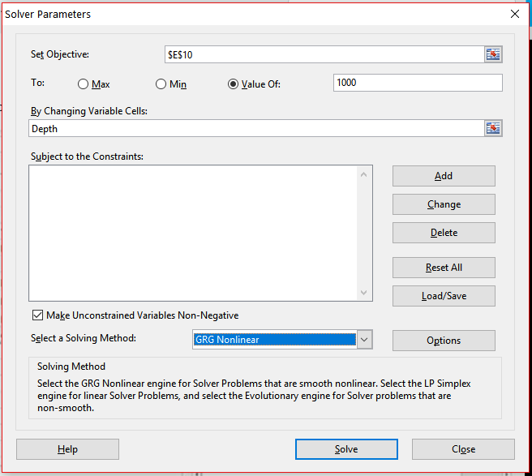
Solver
Depth
Depth <= 6
Depth >= 0

